Slide 1

Programming by Contract
Presented by:
Elizer Ponio Jr.

Slide 2
Software Requirement Specification
A document that describes what the software will do and how it will be expected to perform.

Slide 3
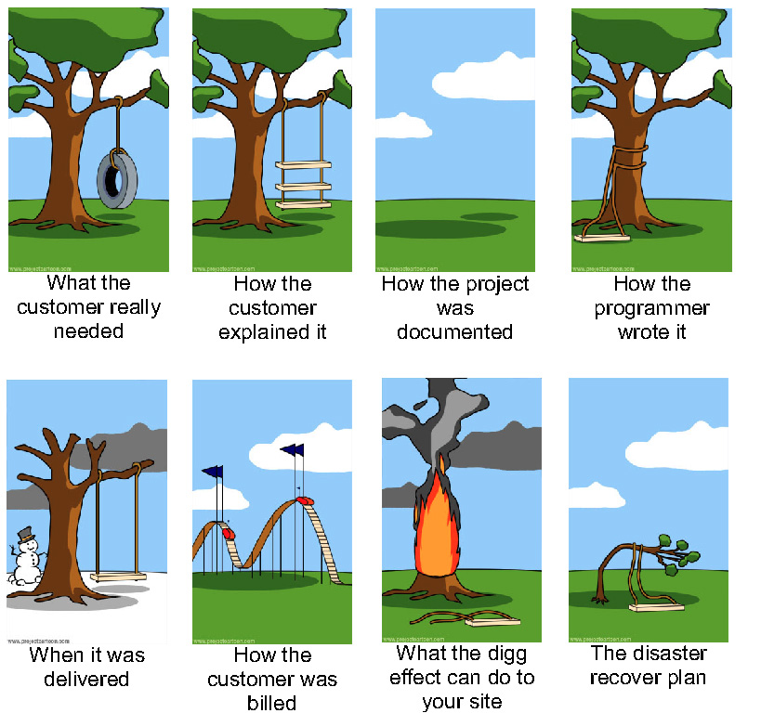

Slide 4

Programming by Contract
Also known as design by contract, contract programming.
Assertions are used in the Design by contract technique to check if the requirements specified in the defined contract are met by the application. They are used to test the assumptions made by the programmer.
Aims to produce reliable software

Slide 5
Programming by Contract
Java does not have native support but there are existing third-party libraries that can be used.
Programming languages with native support for programming by contract include Eiffel and Kotlin.

Slide 6
Reliability
Correctness
Software does what it is supposed to do.
Robustness
Software behaves in some acceptable manner in situations where it cannot do what it is supposed to do.

Slide 7
Assertions
Boolean expressions that allow a program to check itself as it runs.
When an assertion evaluates to true, the program is operating as expected.
When an assertion evaluates to false, it indicates that the program has an error.

Slide 8
Syntax
assert (Boolean condition) : (assertion error message);
assert divisor != 0 : “Divisor cannot be zero!”;

Slide 9
Types of Assertions
Precondition
The specified conditions must be satisfied by the application before calling an external component.
Postcondition
The specified condition must be satisfied by the application after an external condition has been executed.
Invariant
The specified condition must be satisfied by the application.

Slide 10
Example
A stack should not be empty when extracting an element from the stack. This condition is thus checked before extracting an element from the stack. This condition is called a precondition.
Pushing an element into the stack, we need to check whether the element is correctly added to the specified index. This condition is referred to as postcondition.
An invariant condition is when a stack’s number of elements should not exceed its carrying capacity or be equals to empty zero.

Slide 11
Assertions are not…
Assertions are not an error handling mechanism.
They neither handle nor prevent errors.
They do not fix bugs.

Slide 12


Dealing with errors
The first priority when dealing with errors is to detect them and not to hide them.

